Slide 1
MiSTer FPGA
“Preserving the Past of Computing” Alan Reeve Vintage Computing Festival Midwest 2022

Slide 2
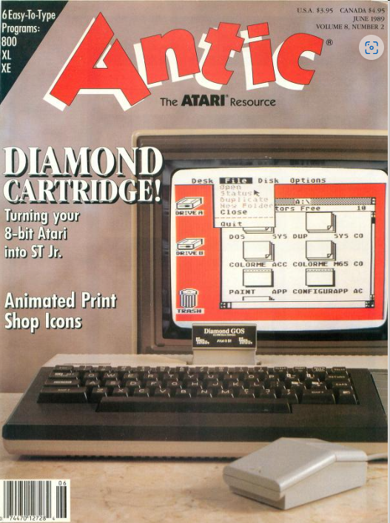
Who am I?
Started in computing with an Apple II (grade school)
Migrated to Atari 8-bit writing commercial software, including Diamond GOS
… then Atari ST and PC clones
Interested in retro gaming and computing in the early 90s when I discovered ColecoVision games (on the Internet newsgroups) were $5 (Venture, Turbo, …)
Fortunate enough to collect when it was affordable in the 90s and early 2000s
Interested in emulation ever since trying to emulate the Atari 8-bits on the Atari ST (hint: not enough power)
Found that accurate emulation really became feasible with PCs in the early 90s with Sparcade being the breakthrough (arcade emulator by Dave Spicer that really doesn’t get the credit it deserves as MAME quickly took over)
Thinks preservation of these old machines is culturally important (all of them!)
Thinks learning computing on these old machines has substantial benefits (as one can understand everything that’s going on, but who can tell me what every process on any given PC is doing?)

Slide 3
How do we preserve these old machines?
Maintenance Keep repairing old systems to keep them working Pros Gold Standard (100% authentic) Cons Parts harder to find / Costly Need electronics knowledge Space for each computer (and everyone needs a backup) | Re-Creation Create new hardware that is the same as the old hardware Pros Close to or same as gold standard? Cons Costly Space | ? | Emulation Writing code on a really fast (relative to the original) computer that tries to act like the original Pros Cheap Digital space only Cons Functionally not the same as the original

Slide 4
…or MiSTer FPGA
FPGA stands for Field Programmable Gate Array which is a software oriented way of creating hardware via a program that describes the logic gates necessary to create an IC
MiSTer is an FPGA oriented solution and is a successor to the MiST where ‘Mi’ comes from MiniMig (an Amiga FPGA solution) and ‘ST’ from the Atari ST
Using HDL (Hardware Definition Language) one can recreate the actual ICs that comprise these older computers in software with pinpoint accuracy
Easier to recreate when original logic diagrams are available otherwise much experimentation is required
The HDL ‘software’ recreation of a piece of hardware is called a ‘core’
Just like with software emulation the results are only as good as the ‘code’
Unlike software emulation a ‘perfect’ core is an exact re-creation of the piece of hardware it intends to re-create
MiSTer is an Open Source project (for the most part) with most cores available at https://github.com/MiSTerFPGA
Pretty good YouTube summary: https://youtu.be/izmsGyTyDJE

Slide 5
What can it do today?
Acorn Archimedes, Atom, Electron Altair 8800 Amstrad CPC, PCW Apple I, IIe and Mac Plus Atari 8-bit and ST Bandai RX-78 BBC Micro Commodore 16, Plus/4, 64, Amiga, PET and VIC-20 Interact Home Computer Jupiter Ace Mattel Aquarius | MSX/2/2+/3 NEC PC-88 Orao Oric-1, Atmos PC XT, 486DX33 PDP-11 Sam Coupe Sinclair QL, ZX Spectrum, ZX80, ZX81 Spectravideo SV-328 TRS-80 CoCo 2, CoCo3, MC-10, Model I X68000 ZX Spectrum Next | Adventure Vision Emmerson Arcadia 2001 Bally Astrocade Atari 2600/5200/7800/Lynx ColecoVision Fairchild Channel Interton VC 4000 Neo Geo AES Nintendo Game Boy, GBC, GBA, NES, SNES Mattel Intellivision Magnavox Odyssey II | Sega Master System, Genesis, Sega CD, 32x and Game Gear Sony PlayStation TurboGrafx-16 Vectrex WonderSwan/WS Color …Many Arcade Cores…

Slide 6
MiSTer Limitations
Just like any computer MiSTer does have memory and speed limitations
Maxes out around technology created around 1995 as made evident by the PC core
PlayStation core is excellent (1995 game system with 3D graphics)
There are other, better and more costly FPGA chips
…but there’s still plenty of pre-1995 stuff to preserve

Slide 7
MiSTer Manual
Many users of MiSTer just want to play old retro games with minimal effort and while I can appreciate that and the work that goes into creating a good, menu driven game compilation I think it’s also important to
Appreciate the technology and where we’ve come from
Document these old systems
Continue to be able to develop software for these old systems

Slide 8
MiSTer Manual
The MiSTer Manual is my effort at creating that ‘What do I do when I first turn this on?’ instructions for all of these systems.
https://github.com/adreeve/MiSTerManual
Break things into
System Overview (Hardware Specs)
Keyboard Mapping Info (How do I type stuff?)
User Interface (Typed commands and/or how to use the GUI)
Storage (How do I load/save stuff?)
Getting started with programming (Often using BASIC)
Links to more comprehensive documentation (Taking the next step)

Slide 9
How do I get a MiSTer?
Terasic DE-10 Nano Board ($180/$220ish but out of stock at present)
I/O Board
Memory (128MB SD RAM)
USB Hub
Case
All together a pretty complete one will cost around $400-$500
I’ve purchased from
UltimateMister.com (Ricardo Saraiva available in the FB group)
There are many other vendors
Plenty of info at
MisterFPGA.org Message Boards
Facebook = MiSTer FPGA Computer
Discord = MiSTer FPGA

Slide 10
Conclusion
Preserving Hardware in HDL is a low level and long term method of preserving old hardware
MiSTer is certainly among the top FPGA devices for retro computing in 2022
MiSTer does have its limits and just like a modern day PC will be replaced by better, future hardware so will it, but the logic of HDL can be ported relatively easily (vs creating it in the first place)
Documenting the hardware is important too
Help!?

